Slide 1



Slide 2
MHC Construction Lending Department Staff
Matthew Bolton, Vice President of Construction Lending
Regina Druetto, Druetto Construction, LLC
David Hancock, Vice President of the Executive Division

Slide 3
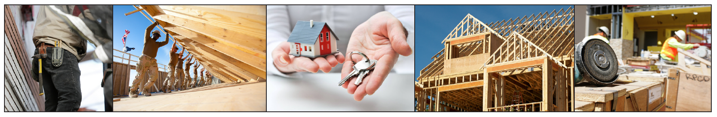
MHC Construction Lending Department
Provides low-interest loans for Single-family new construction
Provides low-interest loans for multi-family new construction and acquisition / rehab
Provides low-interest loan for tax credit new construction and acquisition / rehab developments

Slide 4
MHC Construction Lending Department
Provides mortgage assistance for teachers in areas with critical shortages
Administers 11 Programs totaling $100M in assets
Compliments Federal Grant Programs

Slide 5
MHC Construction Lending Programs
Primary Programs:
HB 530
MAHDF
RLF
FIHOP

Slide 6
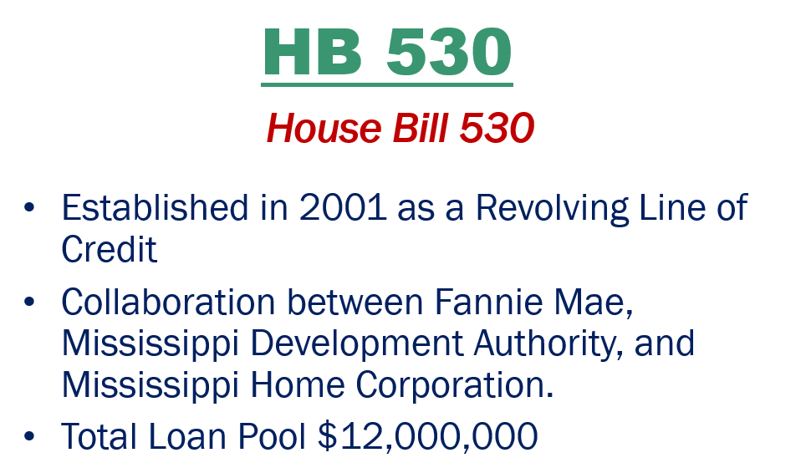

MHC Construction Lending Programs

Slide 7
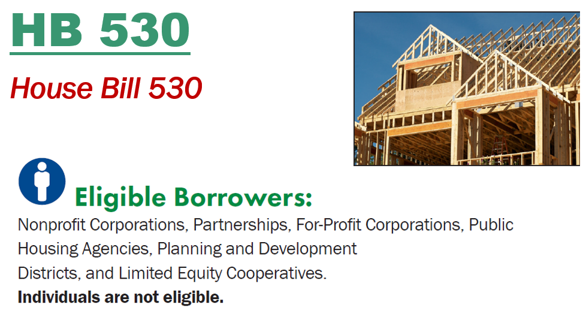
MHC Construction Lending Programs

Slide 8
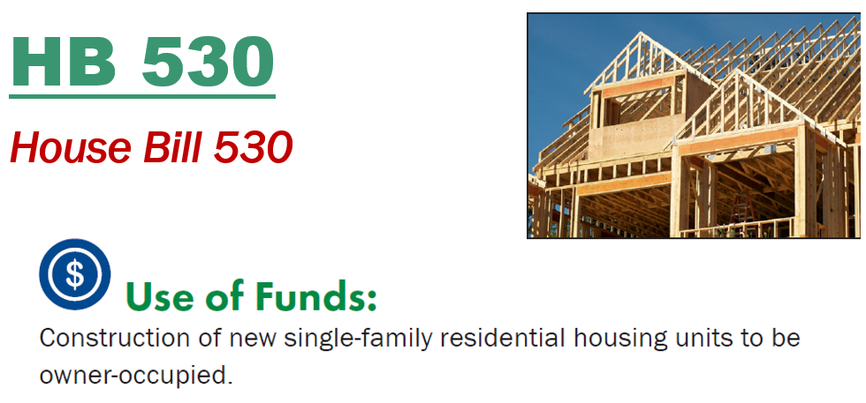
MHC Construction Lending Programs

Slide 9
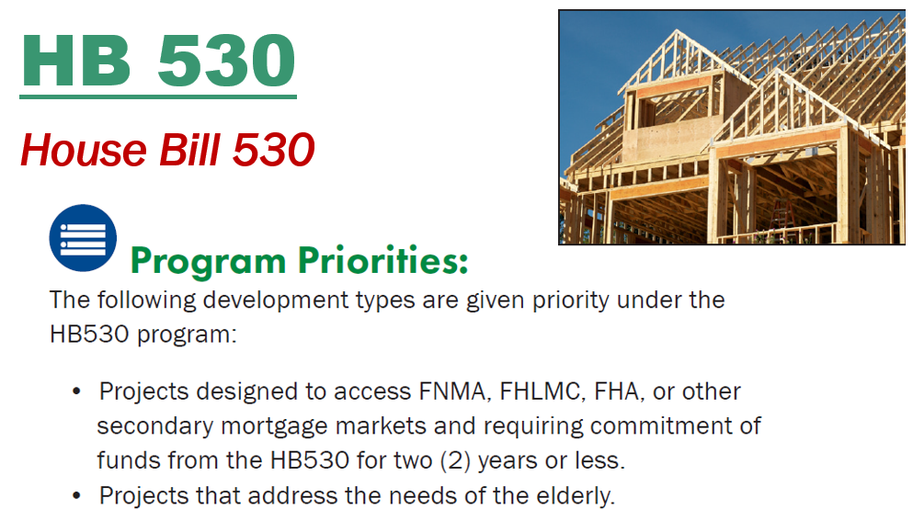
MHC Construction Lending Programs

Slide 10
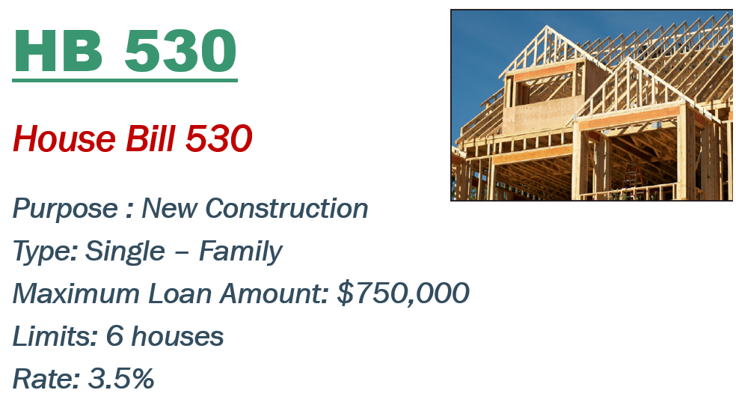
MHC Construction Lending Programs

Slide 11
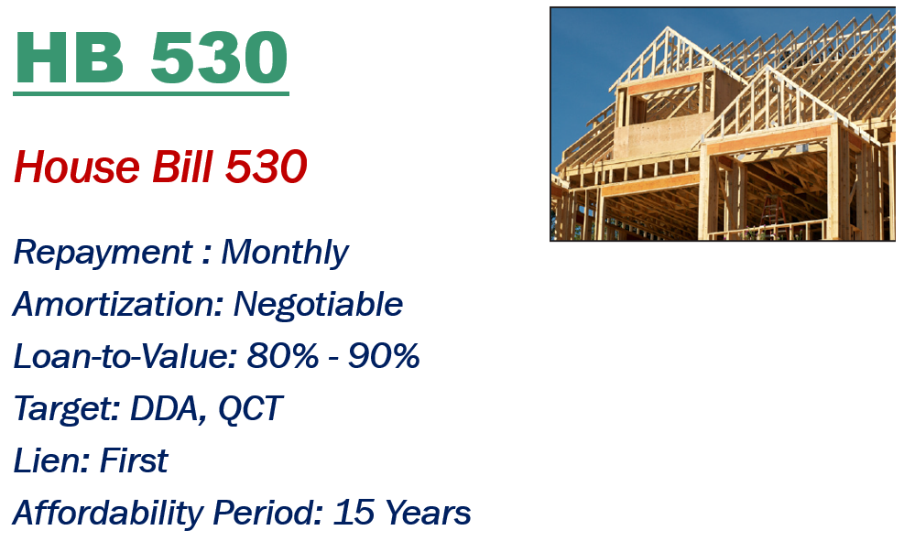
MHC Construction Lending Programs

Slide 12
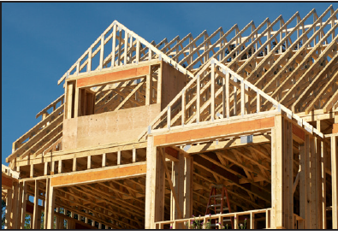
HB 530
House Bill 530
Assumability : No
Pool: $12,000,000
Source: MDA / MHC
Available: $9,100,000
Limits: HH - $122,000

Slide 13
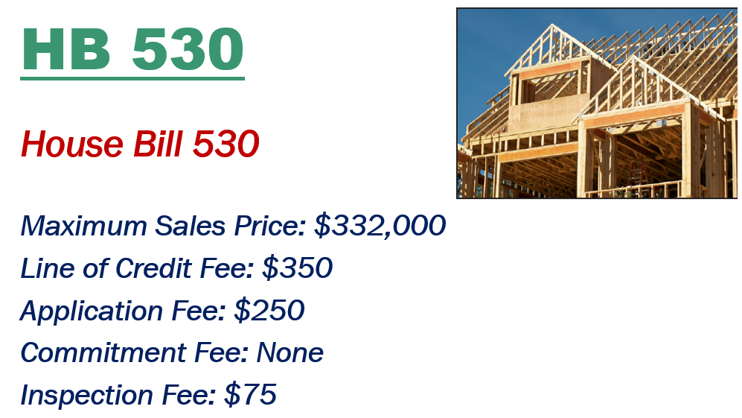
MHC Construction Lending Programs

Slide 14
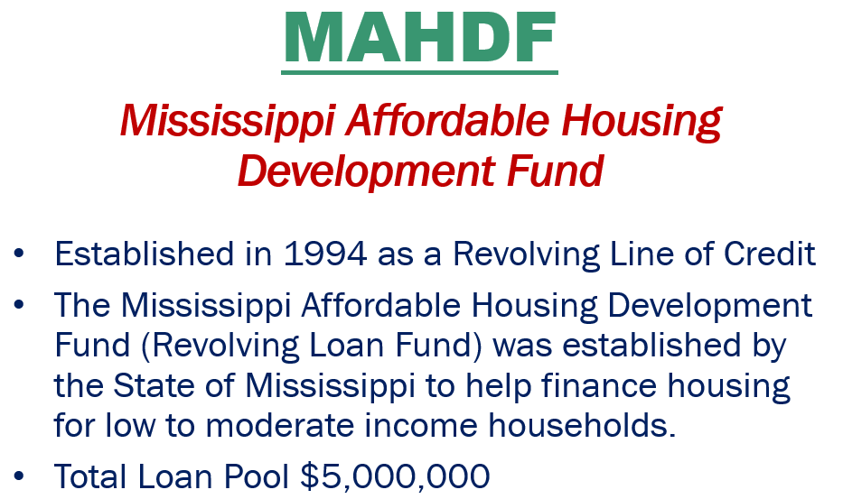
MHC Construction Lending Programs

Slide 15

MHC Construction Lending Programs

Slide 16

MHC Construction Lending Programs

Slide 17

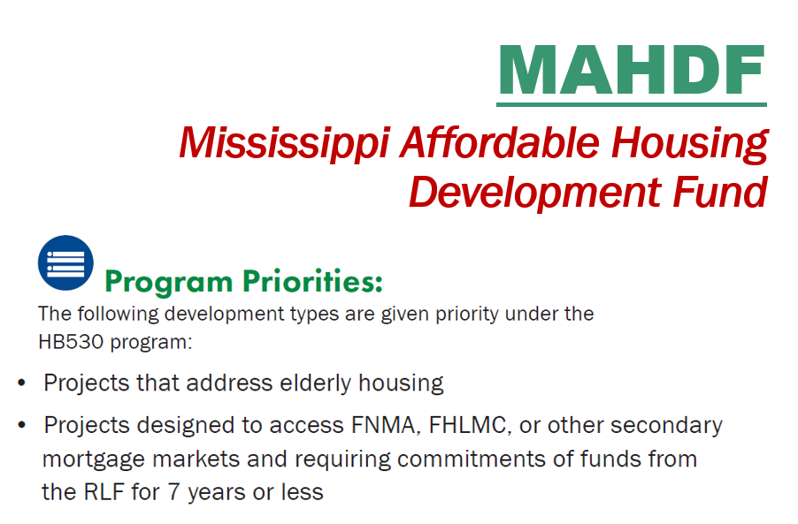
MHC Construction Lending Programs

Slide 18
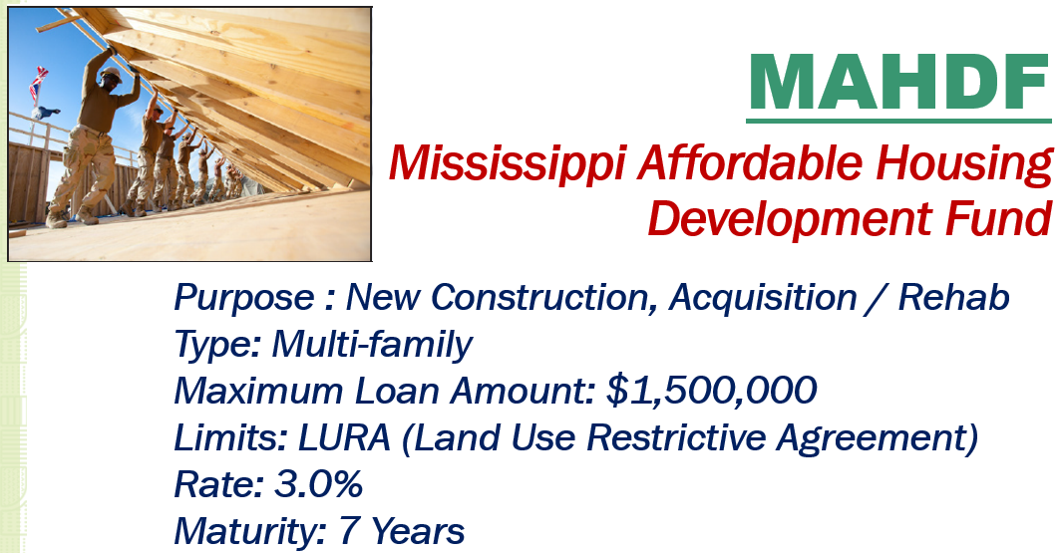
MHC Construction Lending Programs

Slide 19
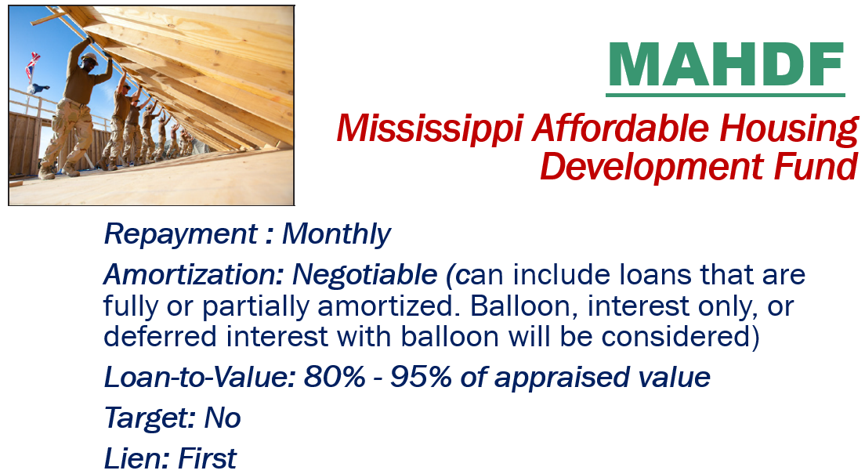
MHC Construction Lending Programs

Slide 20
MAHDF
Mississippi Affordable Housing Development Fund
Affordability Period: 15 Years
Assumability : Yes
Pool: $5 M
Source: MDA / MHC
Available: $1.7 M

Slide 21

MHC Construction Lending Programs

Slide 22
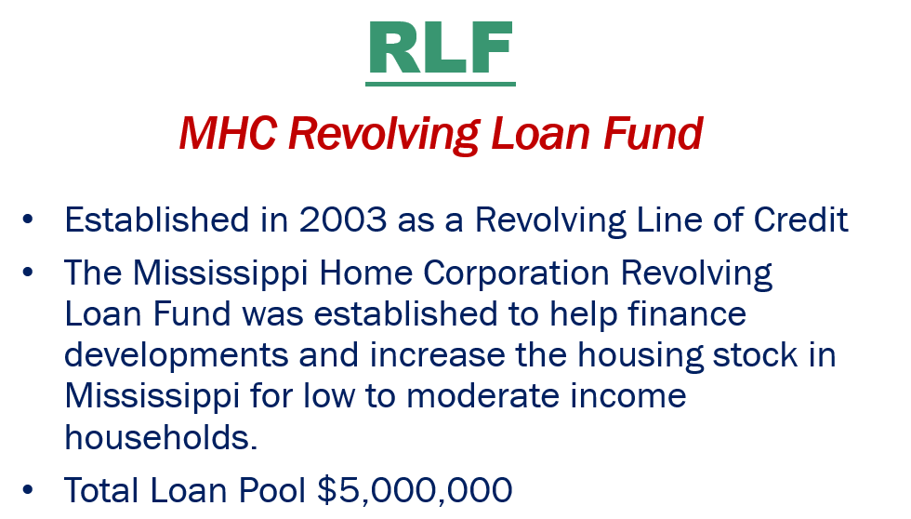
MHC Construction Lending Programs

Slide 23

MHC Construction Lending Programs

Slide 24
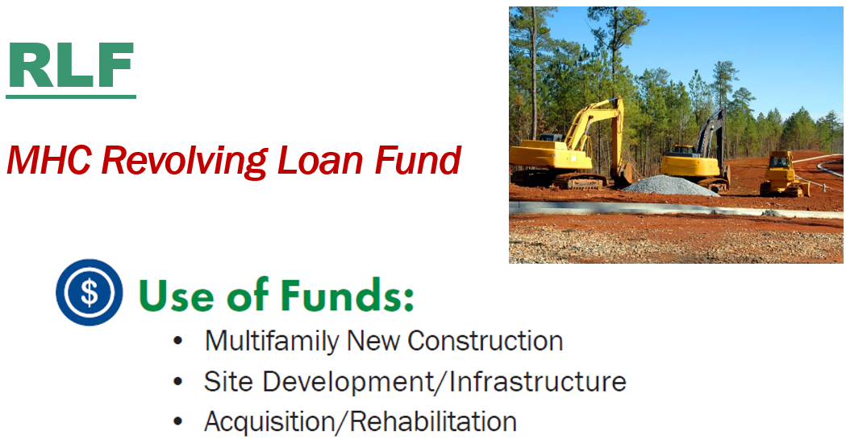
MHC Construction Lending Programs

Slide 25
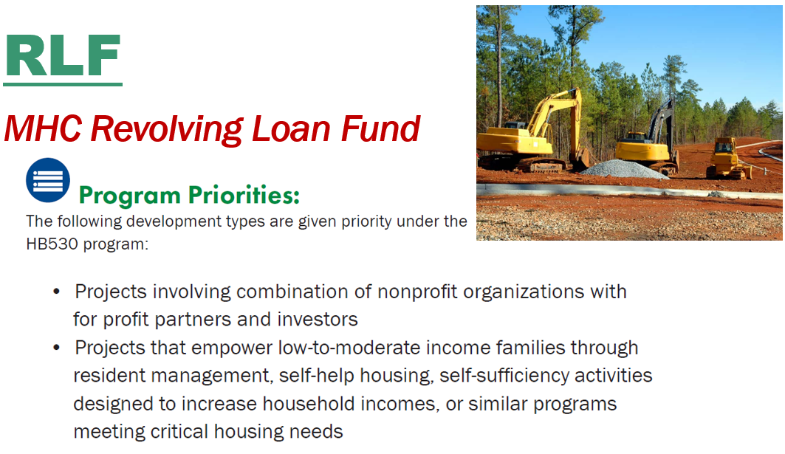
MHC Construction Lending Programs

Slide 26
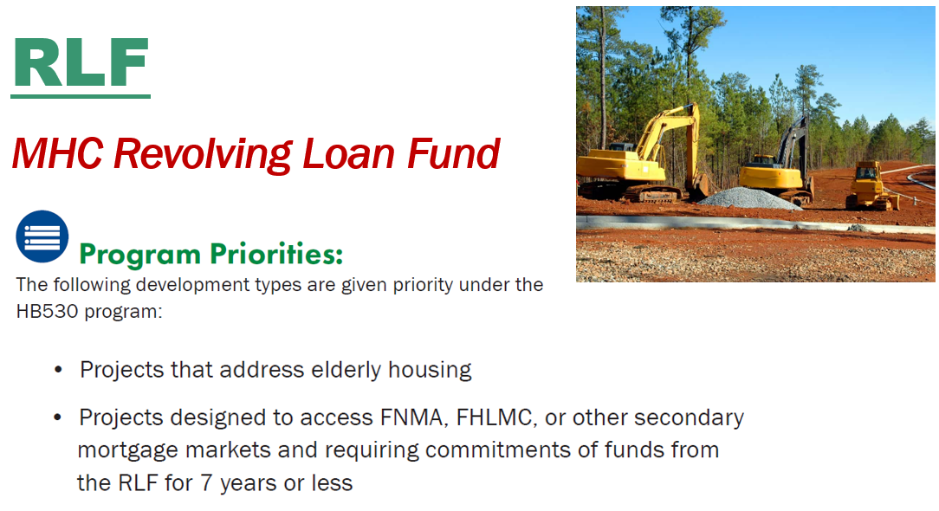
MHC Construction Lending Programs

Slide 27
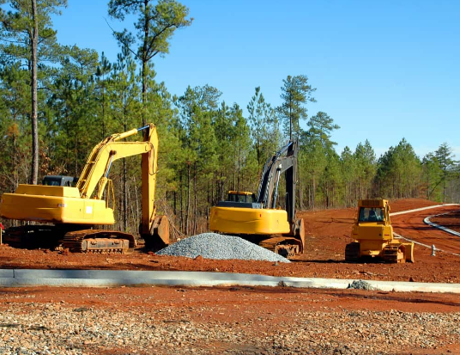
RLF
MHC Revolving Loan Fund
Purpose : New Construction,
Acquisition / Rehab
Type: Multi-family
Maximum Loan Amount: $1,500,000
Limits: LURA (Land Use Restrictive Agreement)
Rate: 3.0%
Maturity: 7 Years

Slide 28
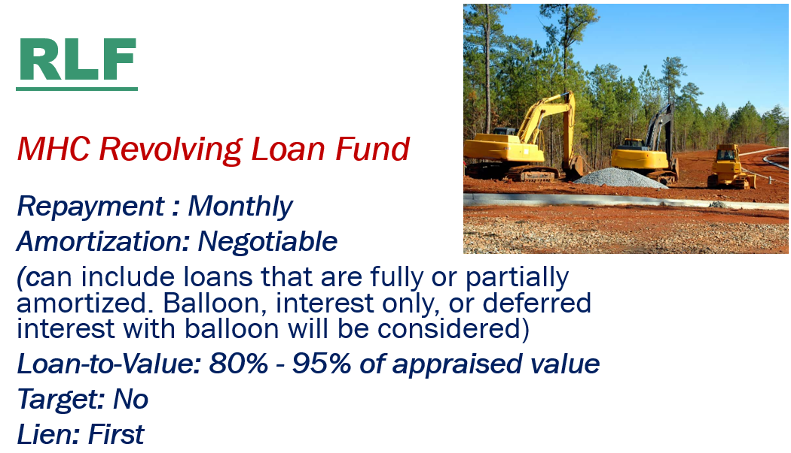
MHC Construction Lending Programs

Slide 29
RLF
MHC Revolving Loan Fund
Affordability Period: 15 Years
Assumability : Yes
Pool: $5,000,000
Source: MHC
Available: $2,600,000

Slide 30
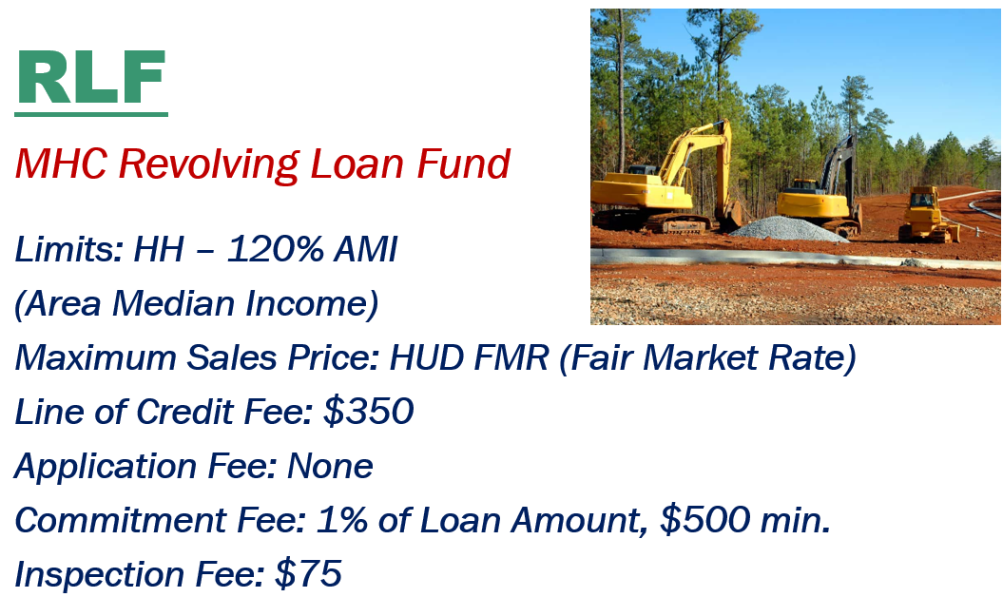
MHC Construction Lending Programs

Slide 31

MHC Construction Lending Programs

Slide 32
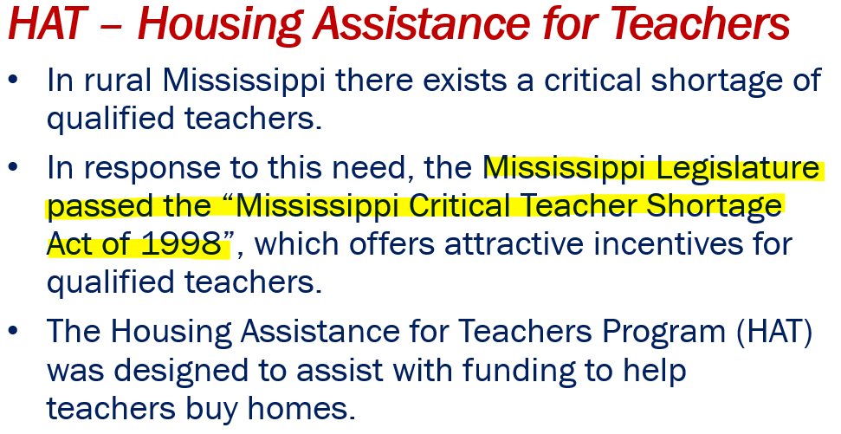
MHC Construction Lending Programs

Slide 33
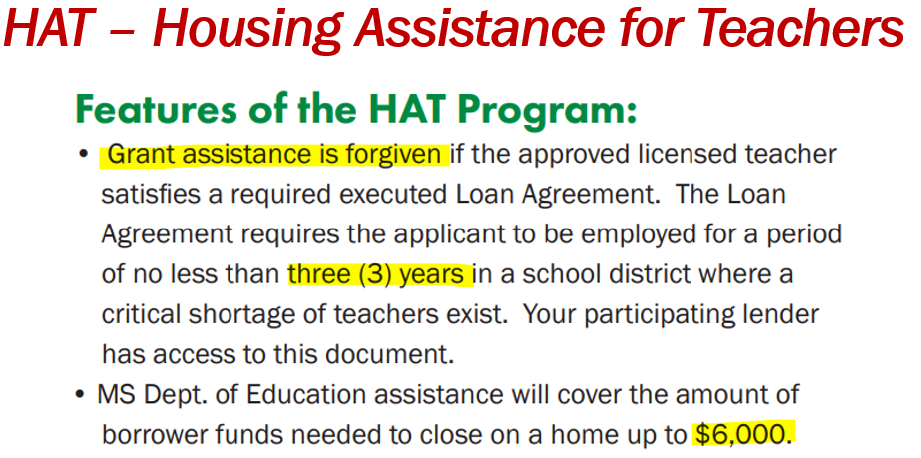
MHC Construction Lending Programs

Slide 34
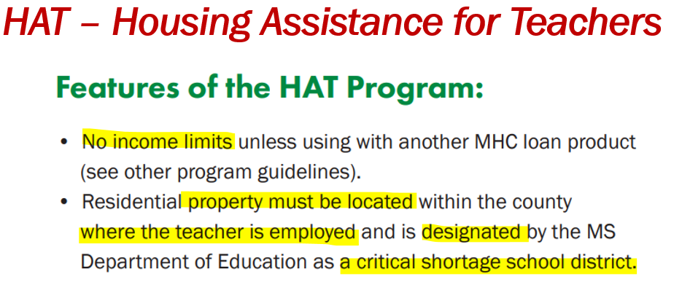
MHC Construction Lending Programs

Slide 35
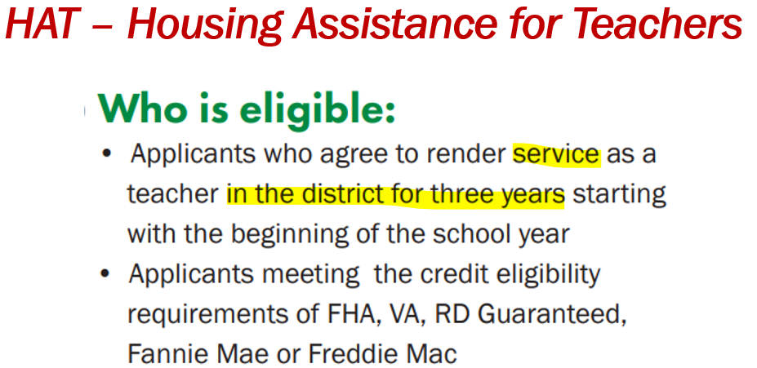
MHC Construction Lending Programs

Slide 36
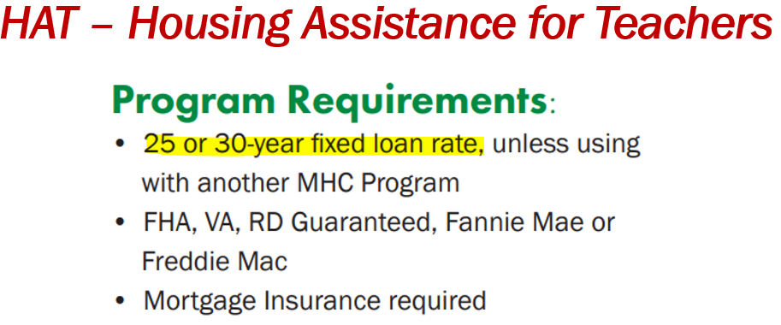
MHC Construction Lending Programs

Slide 37
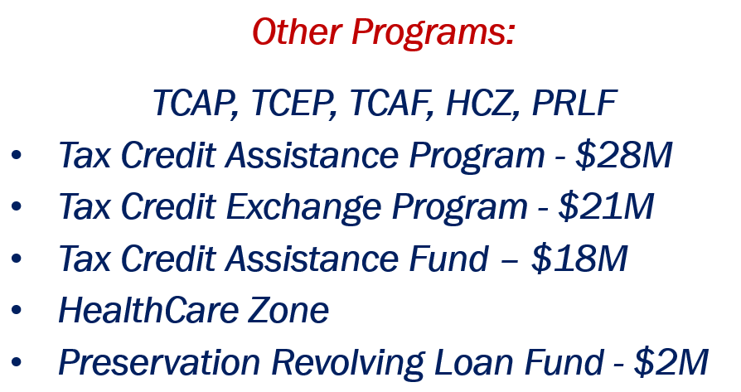
MHC Construction Lending Programs

Slide 38
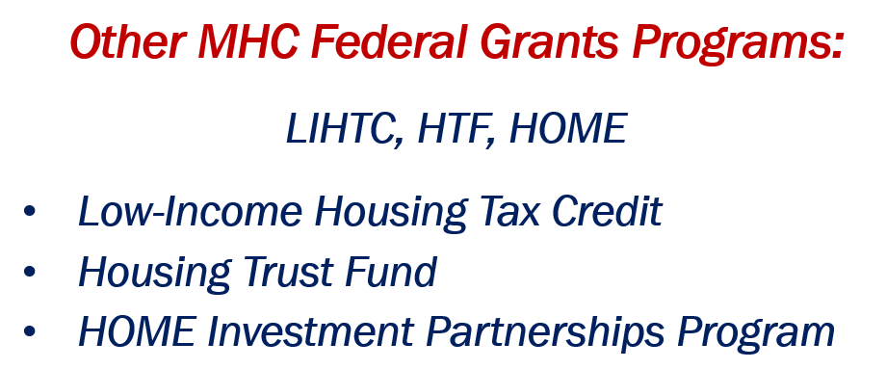
MHC Construction Lending Programs

Slide 39


















Slide 40
MHC Construction Lending Programs
FIHOP's Mission
To fund developers of multi-family housing that utilize low-income housing tax credits.

Slide 41
MHC Construction Lending Programs
The Financial Institutions Housing Opportunity Pool was created in 2002 between statewide lending partners and MHC.

Slide 42
MHC Construction Lending Programs
Before our formation, loans made for CRA credits were typically funded by out-of-state banks. Our program brings Community Reinvestment Act (CRA) investment opportunities back to the Mississippi banking community.

Slide 43
MHC Construction Lending Programs
We exist to enhance Mississippi's long-term economic viability by financing safe, decent, affordable housing and helping working families build wealth.

Slide 44
MHC Construction Lending Programs
FIHOP is a 501(c)3 Mississippi Corporation registered with the State of Mississippi as a Charitable Organization.

Slide 45
MHC Construction Lending Programs
FIHOP is made of 16 participating lenders from across the state and is governed by a Board of Directors. Our loan committee is made up of 8 members. MHC is the current administer of the program.

Slide 46
MHC Construction Lending Programs
FIHOP meets the permanent loan needs of Tax Credit Developers and the CRA Investment compliance needs of our members.

Slide 47
MHC Construction Lending Programs
FIHOP does not fund construction loans. We require 90% occupancy combined with a 1.20 Debt Coverage Ratio for three months before closing.

Slide 48
MHC Construction Lending Programs
FIHOP has closed over $30 million and $12 million has been repaid with $17 million outstanding. FIHOP has $11 million available to lend with total participation commitments of nearly $29 million.

Slide 49
MHC Construction Lending Programs
Our present portfolio is returning a comparable market value rate for our members. In addition, our portfolio has achieved a 100% pay rate for its entire history of loans in service.

Slide 50
MHC Construction Lending Programs
Financial Institutions that participate within FIHOP are satisfied by the minimal Loan to Value Ratios (typically less than 35%) associated with permanent first mortgage loans.

Slide 51
MHC Construction Lending Programs
FIHOP Membership Requirements
Members must commit a minimum of $250,000 to the pool. MHC endorses the program by funding up to 10% of each loan.

Slide 52
MHC Construction Lending Programs
Members participate in each loan to the extent of their commitment to the FIHOP pool and funds are only drawn down from a participant’s commitment at the time a loan is closed.

Slide 53
MHC Construction Lending Programs
The FIHOP Board of Directors consists of one member from each participating financial institution and one from MHC. FIHOP has a loan committee that reviews and recommends each loan to the Board for approval or denial.

Slide 54
MHC Construction Lending Programs
Board of Directors (Officers)
Chairman – Jason Duren
Cadence Bank
Vice-Chairman - Bernard Bridges
Trustmark
Secretary/Treasurer – Steven Cooksey
Great Southern Bank
President - David Hancock
Administrator - Matthew Bolton
Mississippi Home Corporation

Slide 55
FIHOP Board of Directors (Members)
Tracy Alford, Citizens National Bank
Della Brewster, BNA Bank
Billy Brunt, The First Bank
Sandy Collins, BankFirst Financial Services
William Lehr, Community Bank of MS
Jason Lunceford, CB&S Bank
Steven Cooksey, Great Southern Bank
Matthew Creekmore, Renasant Bank
Anthony Montgomery, Hancock Whitney
Dwayne Myers, First Security Bank
Chad Boarman, BankPlus
Mark Wernette, FSNB N.A.

Slide 56
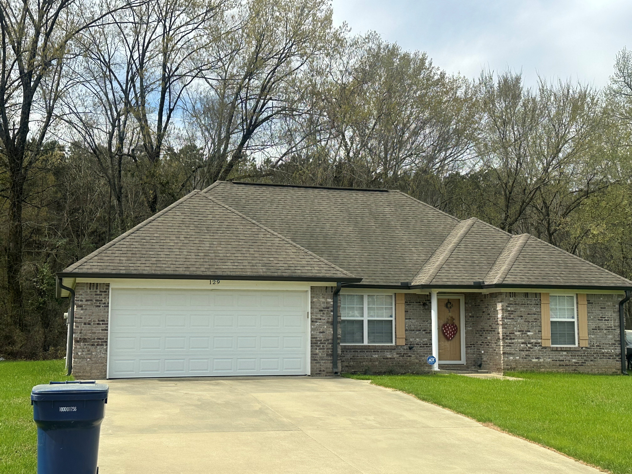
Druetto Construction, LLC

Slide 57
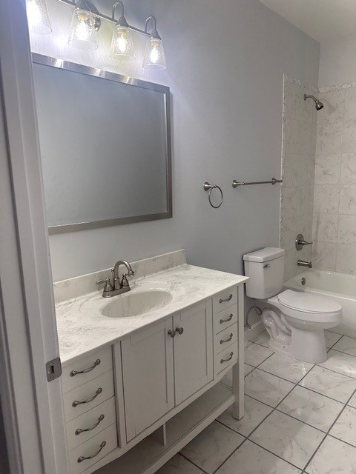
Druetto Construction, LLC

Slide 58
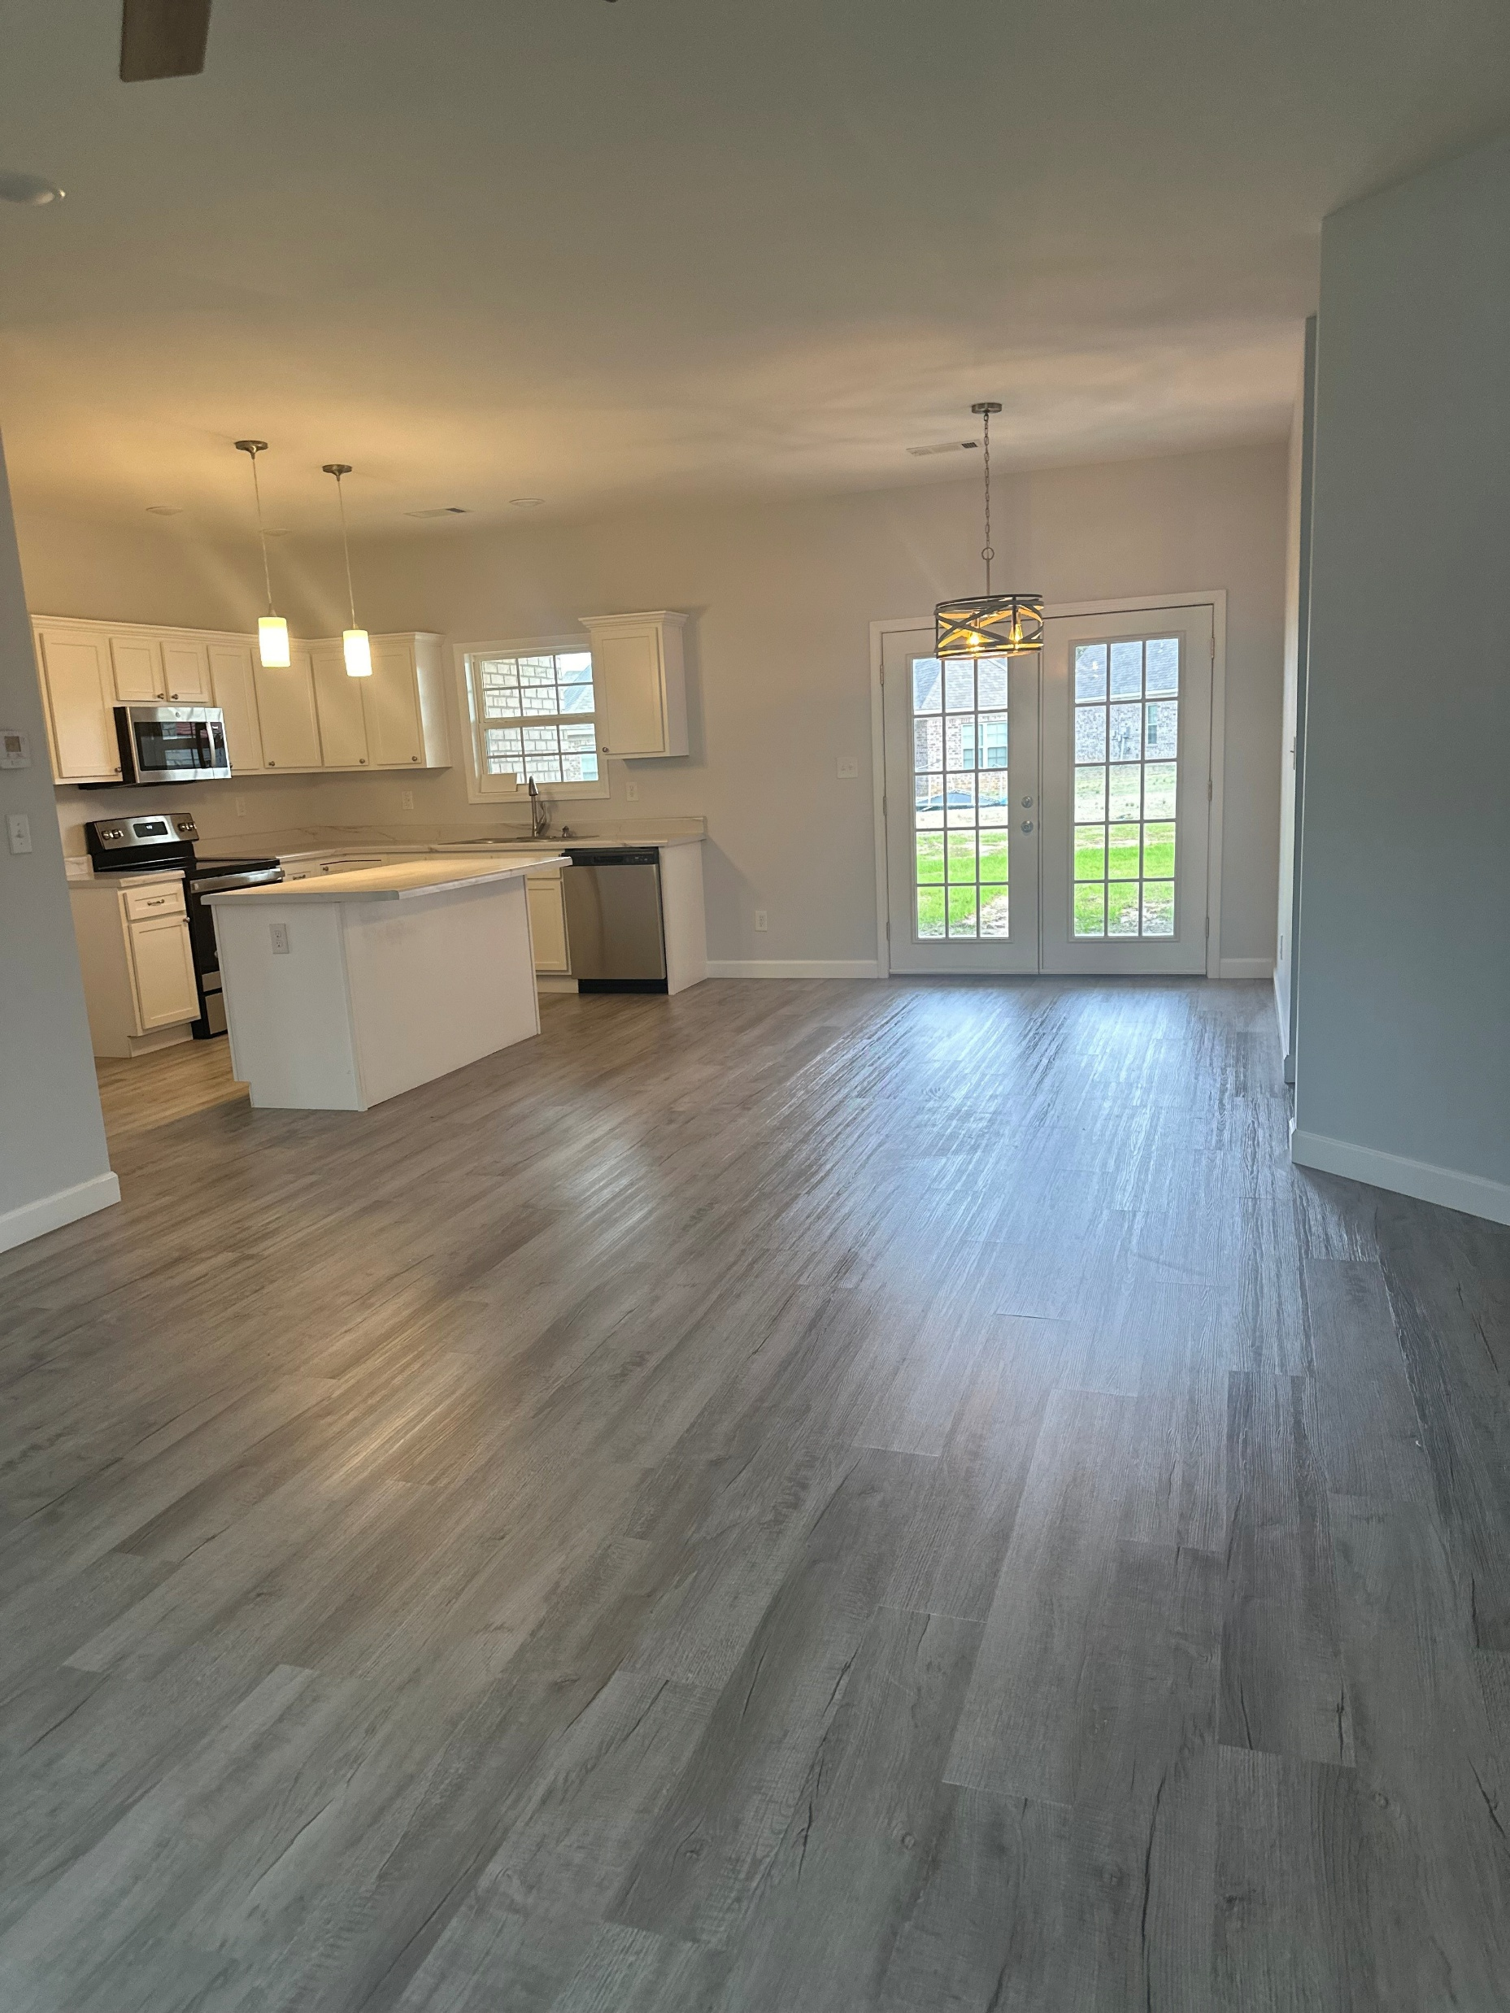
Druetto Construction, LLC

Slide 59
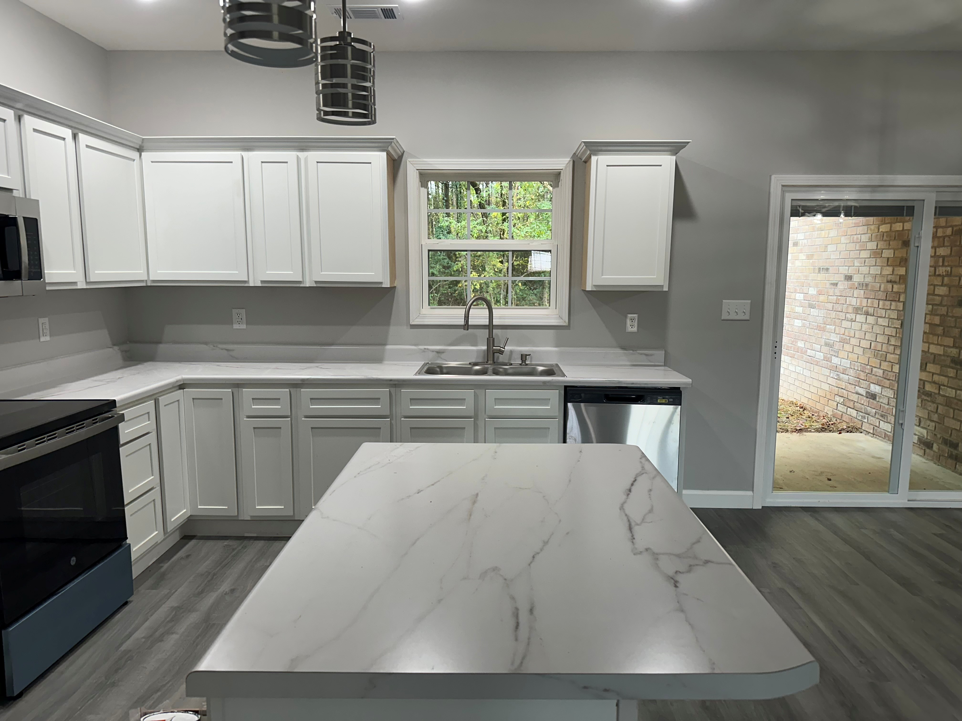
Druetto Construction, LLC

Slide 60
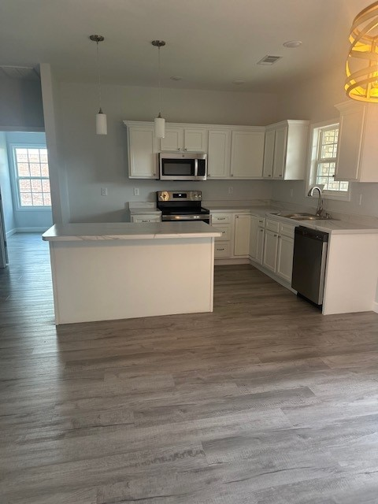
Druetto Construction, LLC

Slide 61
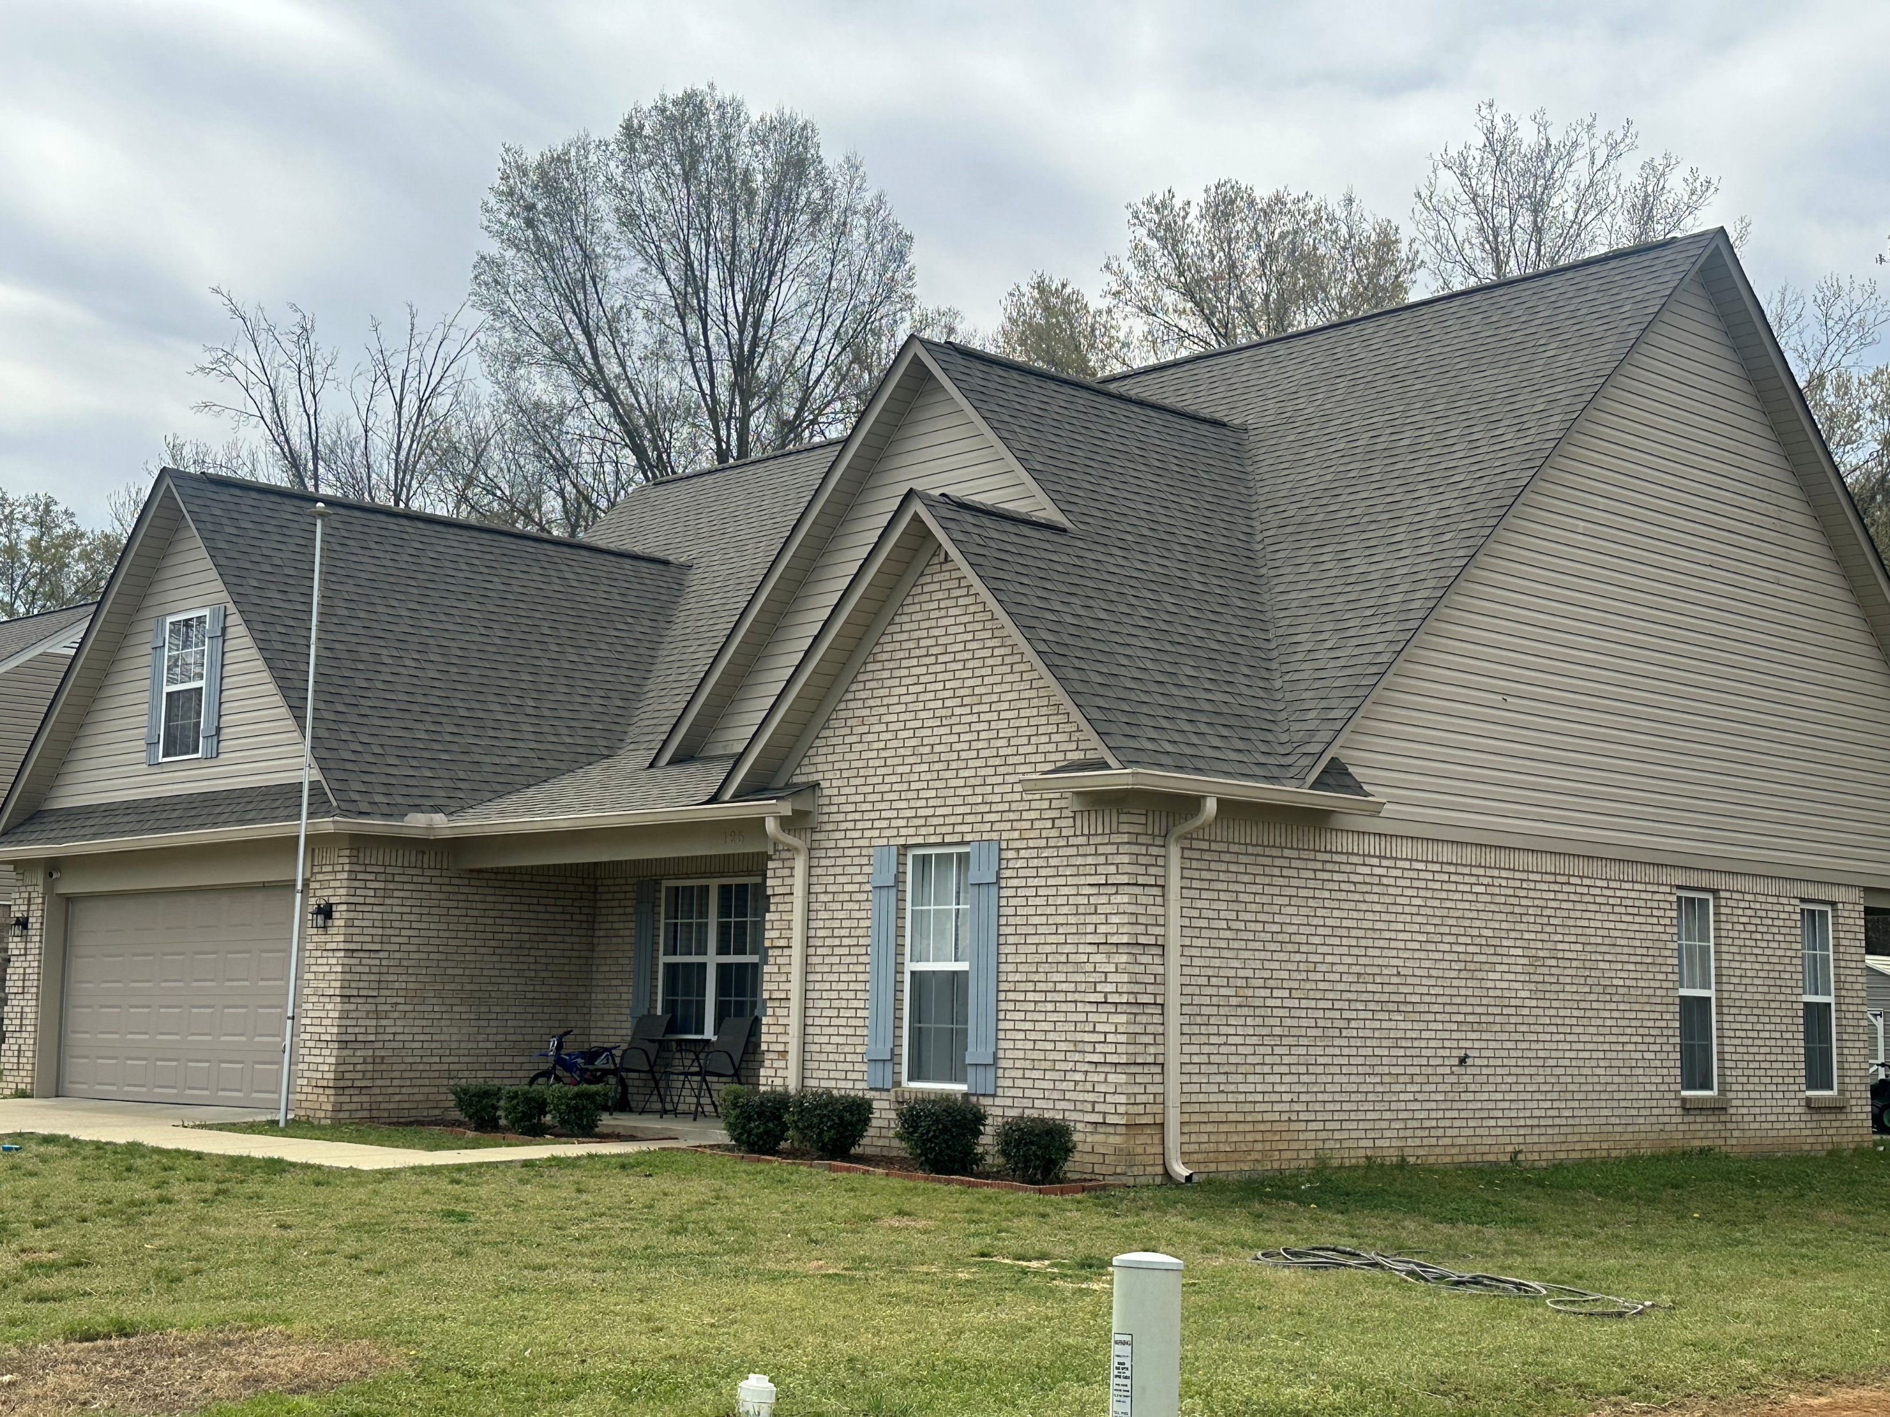
Druetto Construction, LLC

Slide 62
MHC Construction Lending Programs
Questions

Slide 63

MHC Construction Lending Programs

